Slide 1
Program Flow Control

Slide 2
Flow Control
You can’t do with just a list of commands to be done in order
cannot choose whether or not to perform a command
cannot perform the same command more than once
Such programs are extremely limited!
Control structures allow a program to base its behavior on the values of variables
if else, while, do while, for, switch, break, continue

Slide 3
The if else statement
The if-else statement chooses which of two statements to execute
The if-else statement has the form:
if (condition) statement-to-execute-if-true ; else statement-to-execute-if-false ;
Either statement (or both) may be a compound statement
Notice the semicolon after each statement
The else part is optional

Slide 4
Flowchart for the if-else
condition?
true
false
statement-1
statement-2

Slide 5
The if-else Example
if (x >= 0) absX = x;
else absX = -x;
if (itemCost <= bankBalance) { writeCheck(itemCost); bankBalance = bankBalance - itemCost; } else { callHome(); askForMoreMoney(2 * itemCost); }

Slide 6
The while statement
This is the form of the while loop: while (condition) statement ;
If the condition is true, the statement is executed, then the whole thing is done again
The statement is executed repeatedly until the condition becomes false
If the condition starts out false, the statement is never executed at all

Slide 7
Flowchart for the while loop
condition?
true
statement
false

Slide 8
The do-while loop
The syntax for the do-while is:
do { …any number of statements… } while (condition) ;
The while loop performs the test first, before executing the statement
The do-while statement performs the test afterward
If the test is true, the statements in the loop are executed again

Slide 9
Flowchart for the do-while loop
statement
condition?
true
false

Slide 10
The for loop
The for loop is complicated, but very handy
Syntax:
for (initialize ; test ; increment) statement ;
Notice that there is no semicolon after the increment
Execution:
The initialize part is done first and only once
The test is performed; as long as it is true,
The statement is executed
The increment is executed

Slide 11
Flowchart for the for loop
initialize
condition?
true
statements
increment
false

Slide 12
The for loop example
Print the numbers 1 through 10, and their squares:
for (int i = 1; i < 11; i++) { System.out.println(i + " " + (i * i)); }
Print the squares of the first 100 integers, ten per line:
for (int i = 1; i < 101; i++) { System.out.print(" " + (i * i)); if (i % 10 == 0) System.out.println(); }

Slide 13
When do you use each loop?
Use the for loop if you know ahead of time how many times you want to go through the loop
Example: Stepping through an array
Example: Print a 12-month calendar
Use the while loop in almost all other cases
Example: Compute the next step in an approximation until you get close enough
Use the do-while loop if you must go through the loop at least once before it makes sense to do the test
Example: Ask for the password until user gets it right

Slide 14
The switch statement
Switch is Multi-way decisions control statement
The switch statement chooses one of several statements, based on the value on an integer (int, byte, short, or long) or a char expression

Slide 15
Syntax of the switch statement
The syntax is:
switch (expression) { case value1 : statements ; break ; case value2 : statements ; break ; ...(more cases)... default : statements ; break ; }
The expression must yield an integer or a character
Each value must be a literal integer or character
Notice that colons ( : ) are used as well as semicolons
The last statement in every case should be a break;
I even like to do this in the last case
The default: case handles every value not otherwise handled

Slide 16
Flowchart for switch statement
expression?
value
value
value
value
value
statement
statement
statement
statement
statement

Slide 17
Flowchart for switch statement
expression?
value
value
value
value
value
statement
statement
statement
statement
statement
Oops: If you forget a break, one case runs into the next!

Slide 18
The switch statement example
switch (cardValue) {
case 1:
System.out.print("Ace");
break;
case 11:
System.out.print("Jack");
break;
case 12:
System.out.print("Queen");
break;
case 13:
System.out.print("King");
break;
default:
System.out.print(cardValue);
break;
}

Slide 19
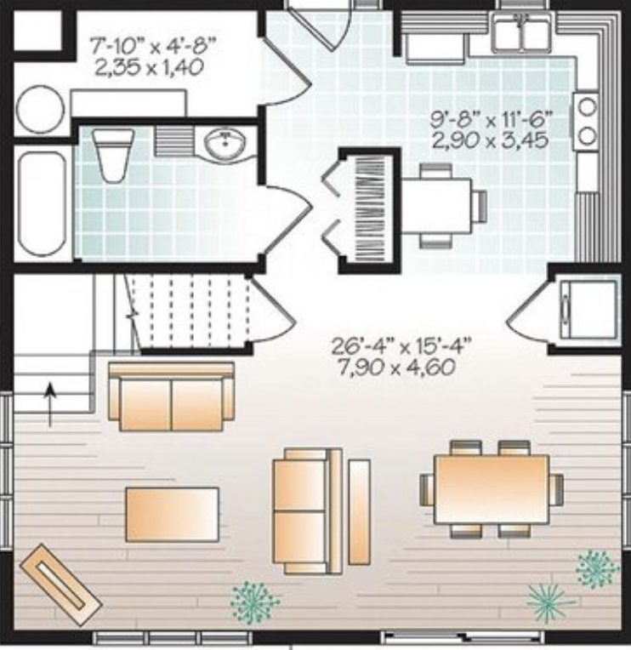
Method
A method in Java is a block of code that only runs when it is called.
A method is a way to perform some task.

Slide 20
Flowchart for the method
void methodA( ) {
Sysout(“Hello”);
}
main(String[] args)
{
…
methodA();
…
methodB();
…
}
int methodB(int a, int b) {
int c = a + b;
return c;
}

